Slide 1

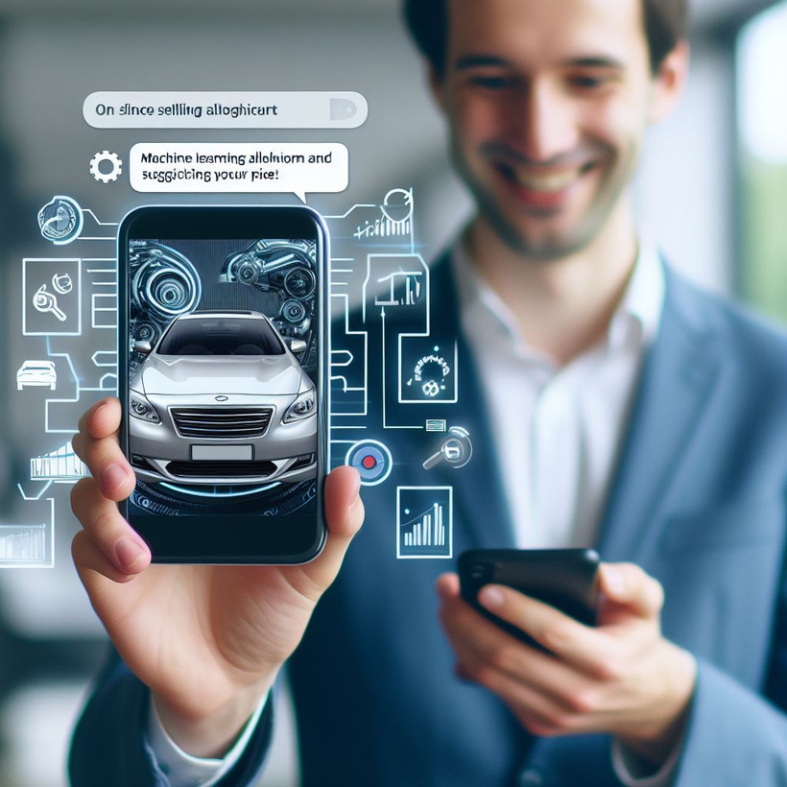
FA23SE12
DriveNet
Vehicle Trading with Price Prediction
Supervised by:
Mis. Sana Maqbool
Final Year Project

Slide 2


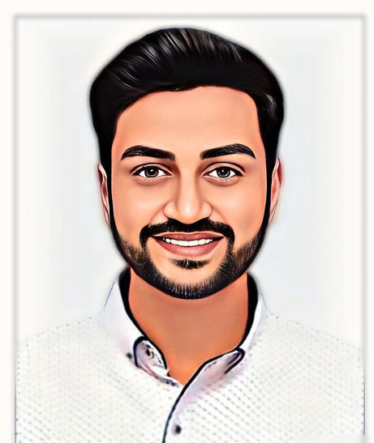

LIST OF
GROUP MEMBERS
Muhammad Zohaib
Muhammad Mehroz
Hafiz Kunwar Muhammad Ahmad
Team Lead
Member
Member
FA20-BSE-051
FA20-BSE-071
FA20-BSE-064

Slide 3

What is Drive Net?
01
DriveNet is a comprehensive platform for vehicle trading, price prediction, and community interaction
02
It is the platform for people to overcome the main questions like “What will be the right price for my car”? “Am I writing the best-selling price of my car”?
DriveNet uses advanced analysis to examine the information sellers provide when creating a car ad. With this data, it predicts and recommends a price for potential buyers.
03
DriveNet also offers a dedicated community page, providing a space for users to share their knowledge, experiences, and address common issues within the automotive community. Connect with fellow enthusiasts, seek advice, and engage in vibrant discussions about all things cars and bikes.
04

Slide 4

Why we Need DriveNet
Problem Statement
01
Sellers struggle to determine the ideal selling price for their used vehicles, often leading to undervaluation or overpricing.
02
Buyers face challenges in making informed decisions due to the absence of clear information on fair market prices for used vehicles.
03
Buyers lack reliable sources for guidance on the right vehicle choice and its appropriate pricing in the second-hand market.
04
Alternatively, Other platforms offer manual inspection which requires experienced inspector, inspection fees and time

Slide 5




LITERATURE REVIEW
EXISTING SYSTEMS
Pakwheels
PakWheels, a prominent player in Pakistan's online automotive marketplace, currently lacks a Machine Learning (ML) module for price prediction. Users seeking better pricing can leverage the "Sell It For Me" service, where buyers pay a fee to the platform, enhancing the overall selling experience and ensuring optimal transaction value.
OLX
OLX is another other web application for selling things not specifically for cars, it also lacks specialized features such as price prediction and community services. Users have the option to "sell faster" by highlighting their ads for 30 or 7 days at respective prices.
01
CarWow
Carwow, a European online platform for buying and selling cars, does not include features for price prediction. While offering a "selling for me" service, can be time-consuming, users may find it lacking in providing a concrete idea of the best price for their vehicles.

Slide 6


LITERATURE REVIEW
EXISTING SYSTEMS
VAVACARS
VAVACARS a Turkish-based company, purchases and sells cars on behalf of buyers, but a significant issue arises as the car's ownership paperwork may not be diligently transferred to subsequent buyers.
True Car
TrueCar, a dealership-maintained platform, raises concerns as sold cars may retain the original seller's name, leading to legal complications. Users may face pricing confusion, and the platform lacks a dedicated community page for advice-seeking within the automotive community.
02

Slide 7






OUR SOLUTION
Create an advertisement
Give car details
Get Predicted Price
01
Analyzing car details using ML module
No Inspection fees
Instant vehicle worth estimate

Slide 8
OUR SOLUTION
01
DriveNet is a simple and intuitive web-based platform, ensuring ease of use for both buyers and sellers in the automotive marketplace.
02
The platform incorporates a price prediction module. When seller creates car advertisements, it analyzes provided details to predict an optimal price. Users can choose to accept the suggested price or input their own
03
Buyers benefit from real-time price visibility during advertisement visits, providing them with valuable insights into the predicted value of their car. In this way, our system is fair with both sellers and buyers.
02
DriveNet incorporates a built-in chat module, fostering seamless communication between buyers and sellers. This feature ensures a direct and efficient channel for users to discuss details, negotiate, and finalize transactions within the platform.
04

Slide 9
OUR SOLUTION
05
DriveNet stands out by being completely free of inspection fees and additional charges, providing an instant estimate of vehicle price worth.
06
DriveNet uses the power of latest Machine Learning technolog to predict the optimal price of the vehicle
03

Slide 10
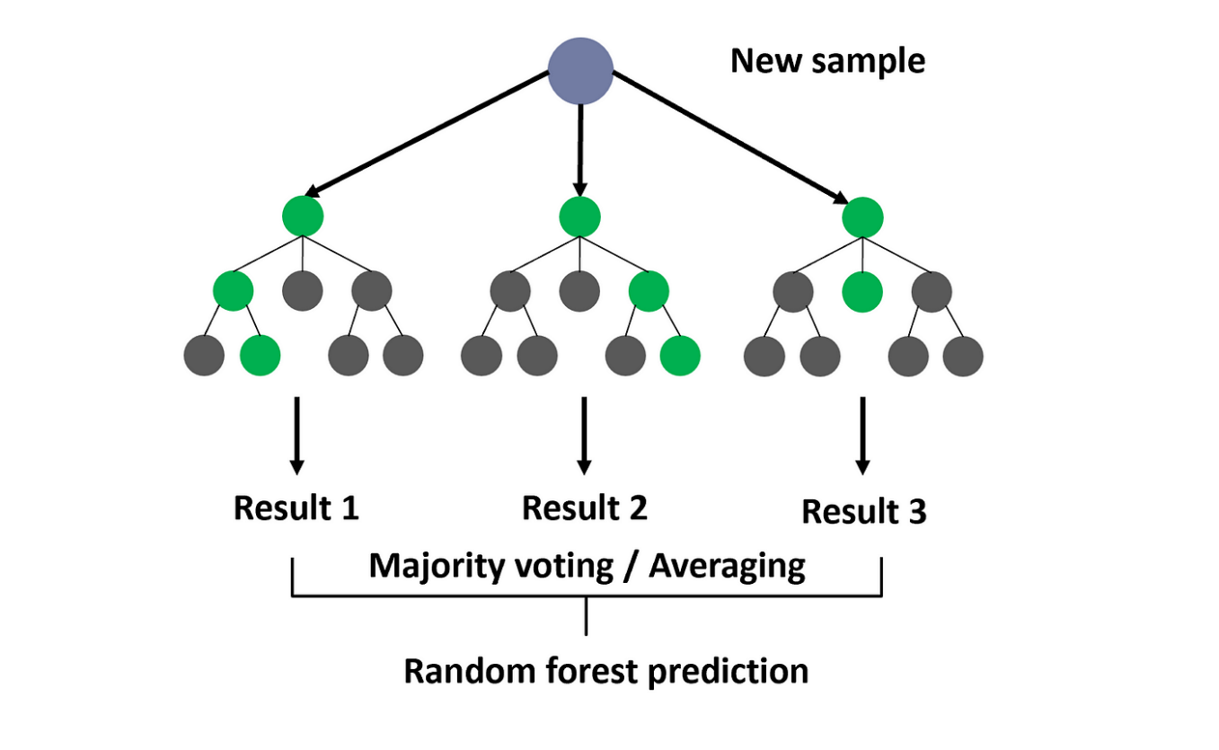
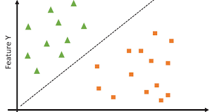
MACHINE LEARNING
01
Random Forest Model
Can handle complex relationships – many features of car contribute to its price so complex relationship exists
Feature Importance – Features can be sorted by their importance e.g. car factory price may be at higher importance
Handles missing data while maintaining accuracy – some sellers may not mention car condition
02
Support Vector Machines
Works with high dimensional data – car make, model, variant, year of manufacture, mileage, factory price, condition scale, and many more
Encourages dimensionality reduction – reducing many features to less features
SVM is less sensitive to outliers in the data compared to some other regression techniques. Outliers, which might be present in car price datasets due to various factors, have a limited impact on the SVM regression model.
03

Slide 11
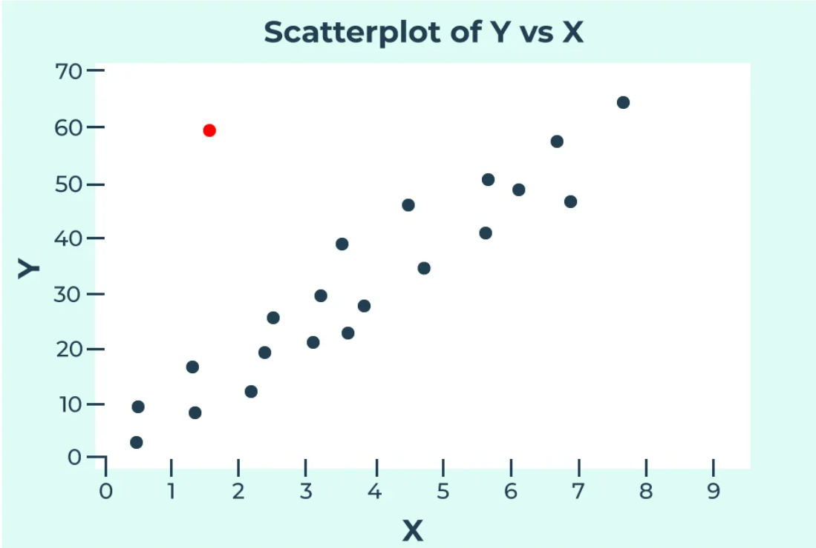
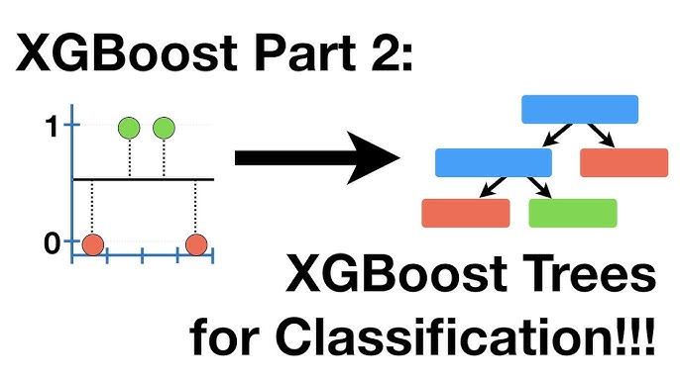
MACHINE LEARNING
03
K – Nearest Neighbors (KNN)
No training phase – so quick way to test the system, and compare its results with other models
KNN can adapt well to changes in feature importance. If certain features become more or less influential in determining car prices, KNN will naturally adjust its predictions based on the proximity of instances in the feature space.
KNN provides straightforward interpretability. The prediction is based on the actual instances in the dataset, making it clear which features are influencing the prediction.
04
eXtreme Gradient Boosting (XGBoost)
XGBoost, being an ensemble learning method, can capture non-linear patterns in the data. It excels in situations where the relationship between car features (such as engine size, horsepower, and fuel efficiency) and price is not easily represented by a linear model.
XGBoost is known for its high predictive accuracy. In various machine learning competitions, XGBoost has been a go-to algorithm due to its ability to deliver top-notch performance.
03

Slide 12
MACHINE LEARNING
05
eXtreme Gradient Boosting (XGBoost)
XGBoost, being an ensemble learning method, can capture non-linear patterns in the data. It excels in situations where the relationship between car features (such as engine size, horsepower, and fuel efficiency) and price is not easily represented by a linear model.
XGBoost is known for its high predictive accuracy. In various machine learning competitions, XGBoost has been a go-to algorithm due to its ability to deliver top-notch performance.
03

Slide 13



SO FAR
WORK DONE
To ensure project success, we developed a project plan and followed this checklist:
Identified potential problems, objectives, and solutions
Reviewed related literature and specified requirements
Developed system diagrams
Written test cases for smooth operation
Planned for future work and ensure schedule adherence.
For implementation has successfully implemented its Figma design, ensuring a well-crafted and visually pleasing platform. This execution serves as a solid foundation for development, guaranteeing a smooth and user-friendly interface during implementation.
Documentation
Implementation

Slide 14


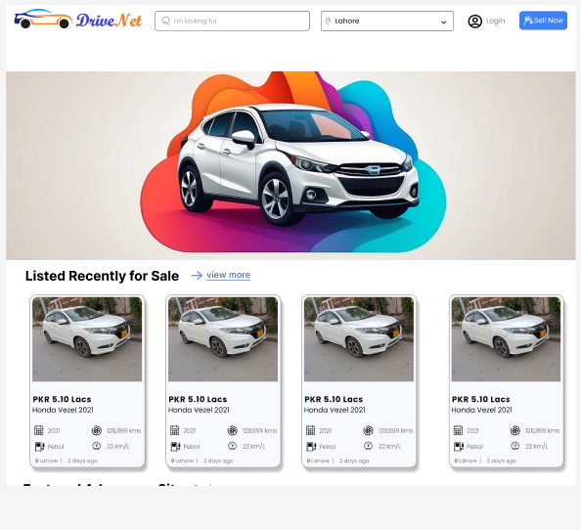
SCREENSHOTS OF
FRONTEND
Goto FIGMA
01

Slide 15
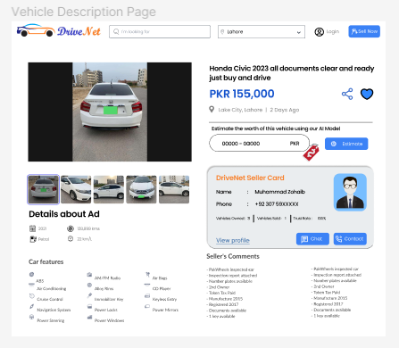
SCREENSHOTS OF
FRONTEND
02

Slide 16
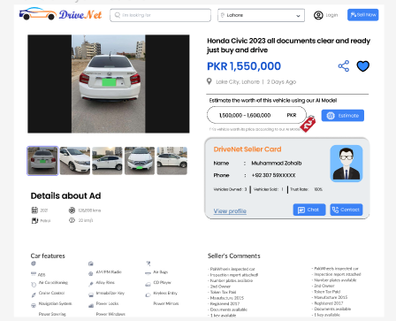
SCREENSHOTS OF
FRONTEND
03

Slide 17
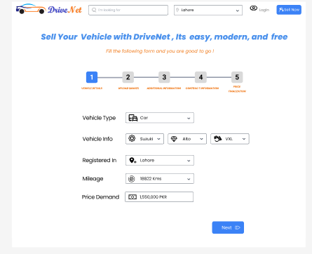
SCREENSHOTS OF
FRONTEND
04

Slide 18
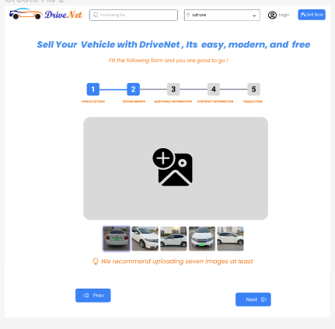
SCREENSHOTS OF
FRONTEND
06

Slide 19
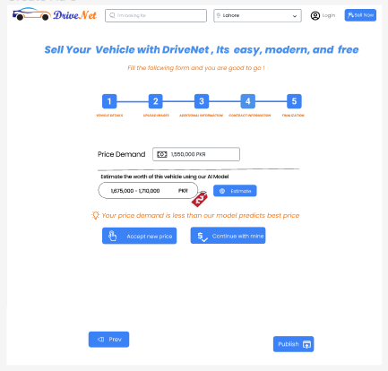
SCREENSHOTS OF
FRONTEND
07

Slide 20
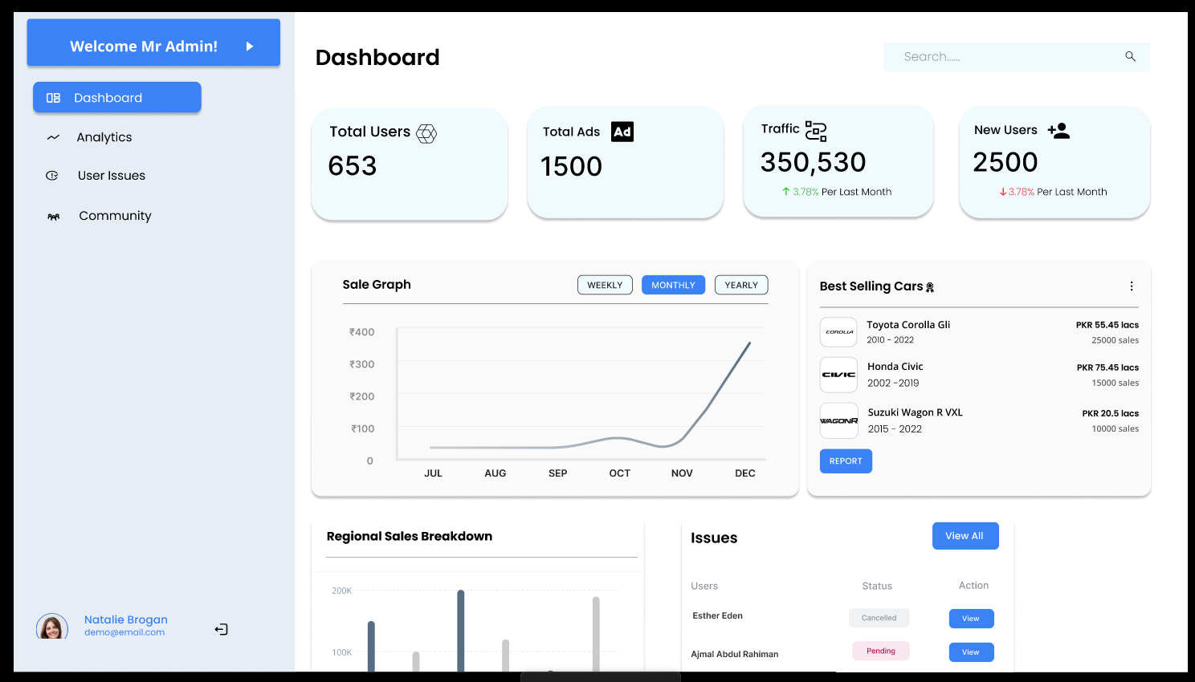
SCREENSHOTS OF
FRONTEND
08

Slide 21
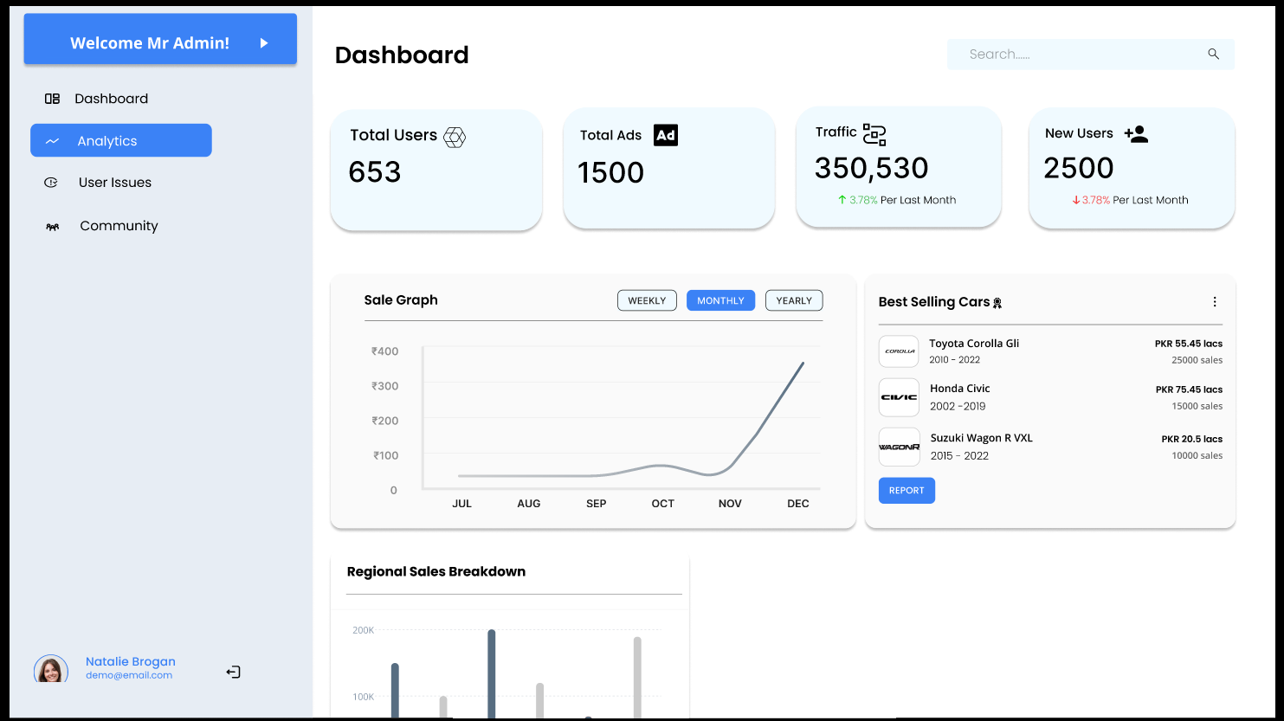
SCREENSHOTS OF
FRONTEND
09

Slide 22
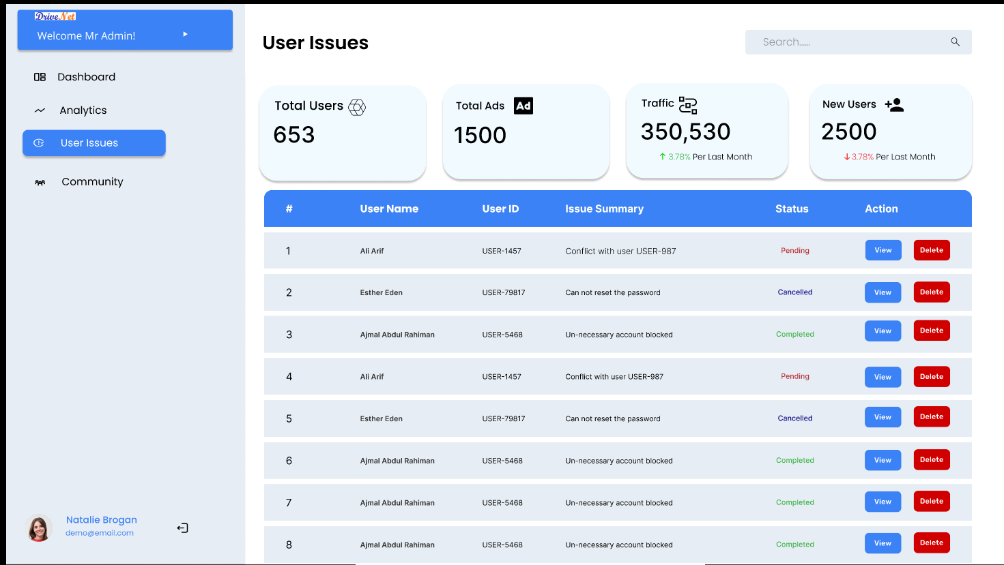
SCREENSHOTS OF
FRONTEND
10

Slide 23
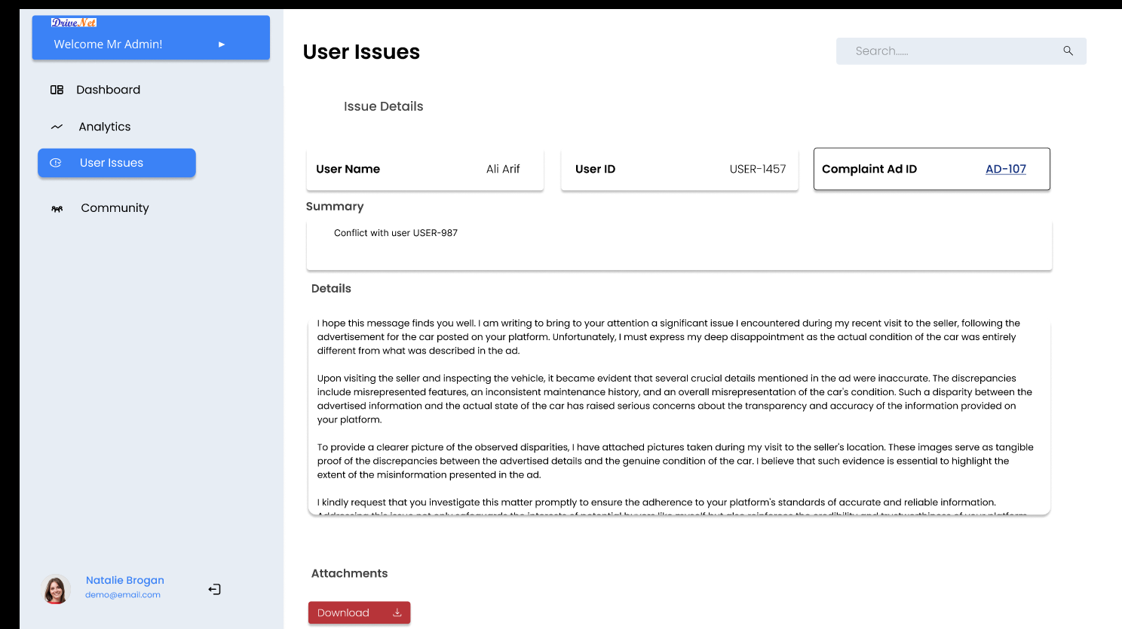
SCREENSHOTS OF
FRONTEND
11

Slide 24
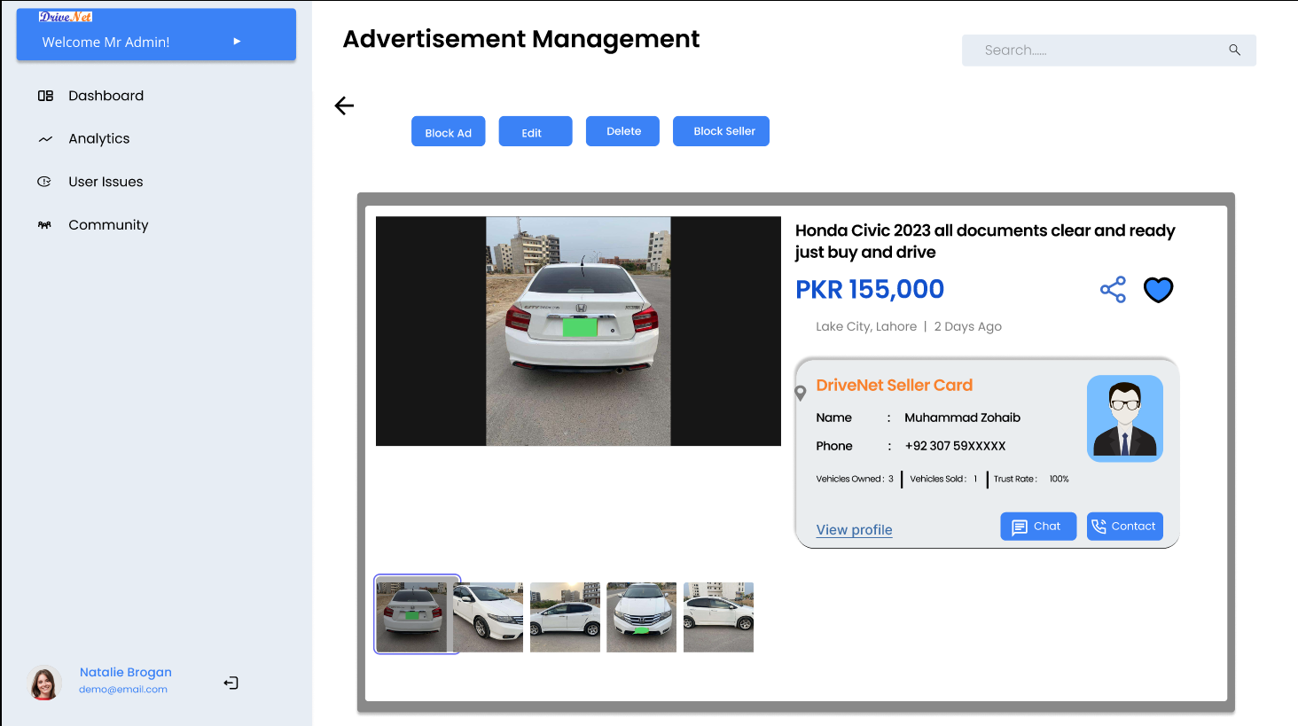
SCREENSHOTS OF
FRONTEND
12

Slide 25
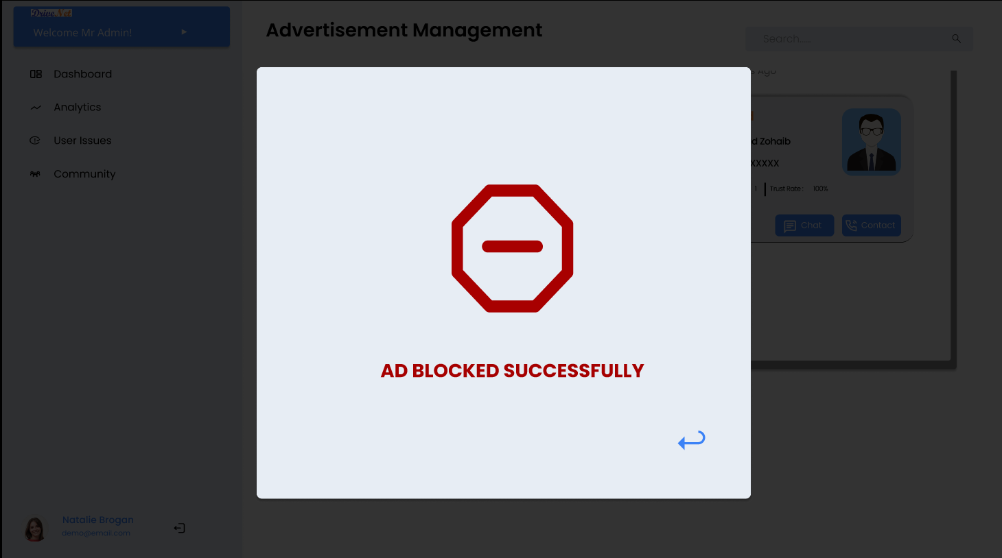
SCREENSHOTS OF
FRONTEND
12

Slide 26
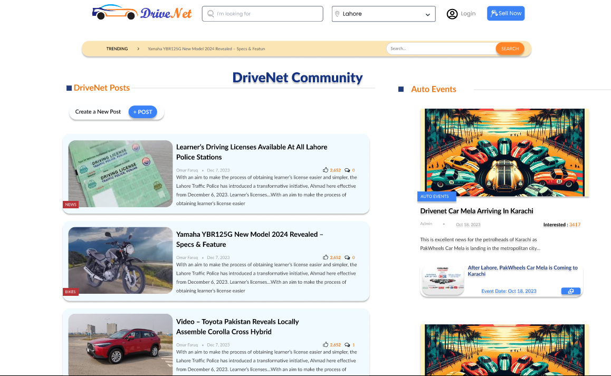
SCREENSHOTS OF
FRONTEND
12

Slide 27
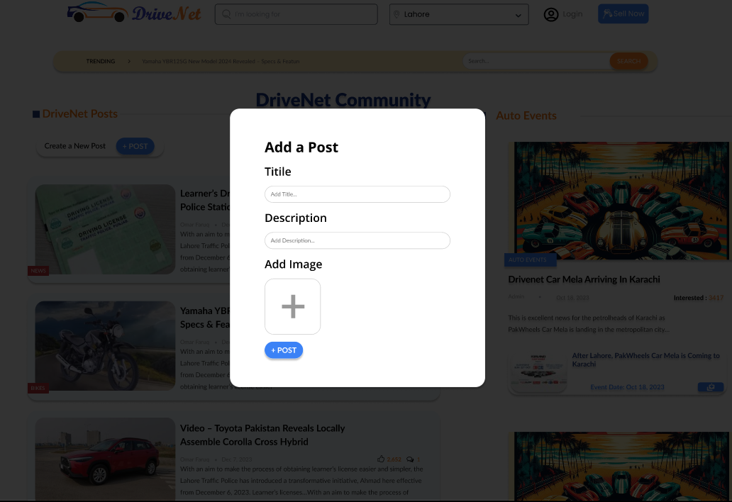
SCREENSHOTS OF
FRONTEND
12

Slide 28
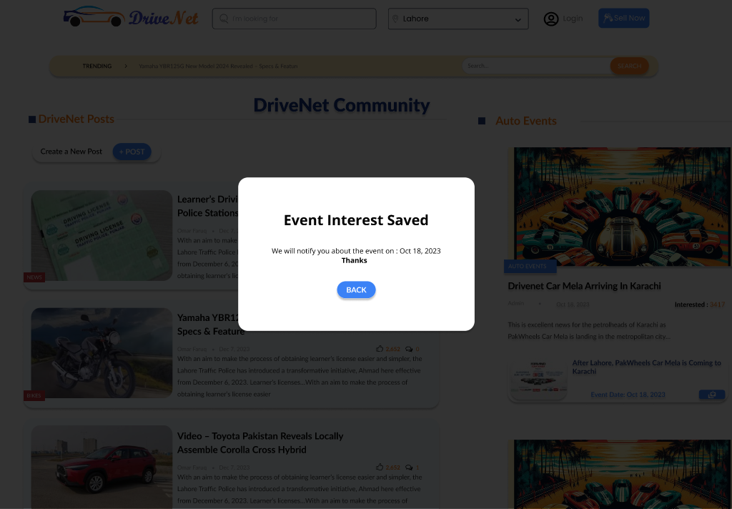
SCREENSHOTS OF
FRONTEND
12

Slide 29
A Long Term
FUTURE WORK
Vehicle Condition Detection with Computer Vision
01
Employ convolutional neural networks (CNNs) to process and analyse car images, enabling the detection of scratches and other damages with a high degree of accuracy.
Integration with Emerging Technologies
02
Explore the seamless incorporation of AR and VR technologies to offer virtual car test drives and immersive experiences.
Collaboration and Partnerships
03
Explore partnerships with car dealerships to enhance the availability of real-time market data and improve the accuracy of predictions.

Slide 30

THANK YOU
FA23SE12
DriveNet
Supervised By: Miss. Sana Maqbool

